Slide 1

The Chengyang Wind and Rain Bridge
by Lillian

Slide 2
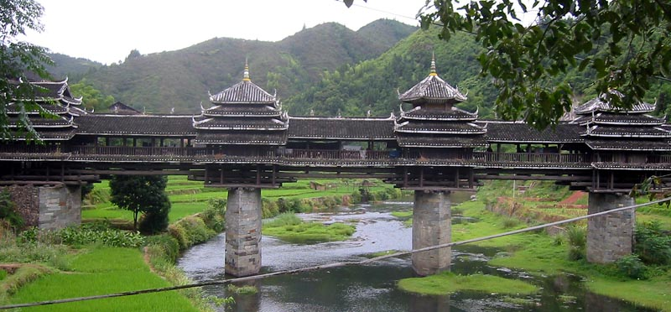
Length and height
10.6 meters high
64.4 meters long
3.4 meters wide

Slide 3
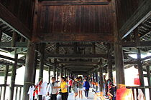
When
The Chengyang bridge was built in 1912

Slide 4
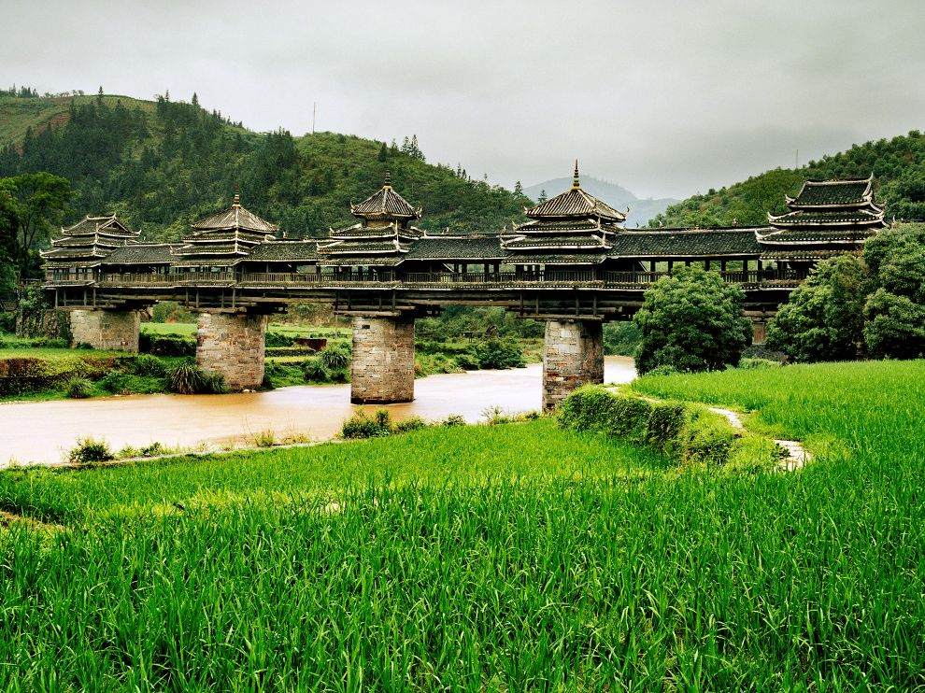
location
The Chengyang Bridge is over the Linxi River

Slide 5
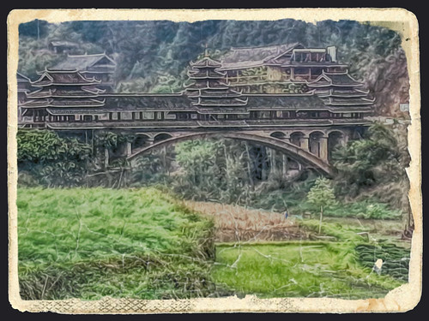
Interesting facts
程陽風雨橋
How to spell Chengyang bridge in China –

Slide 6
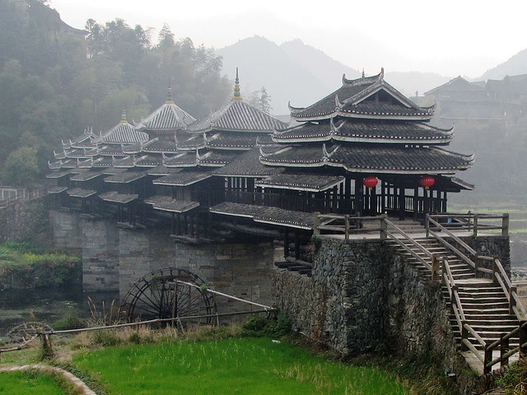
Interesting facts
The Chengyang bridge has benches along it’s wooden railings for rest and for relaxing.

Slide 7
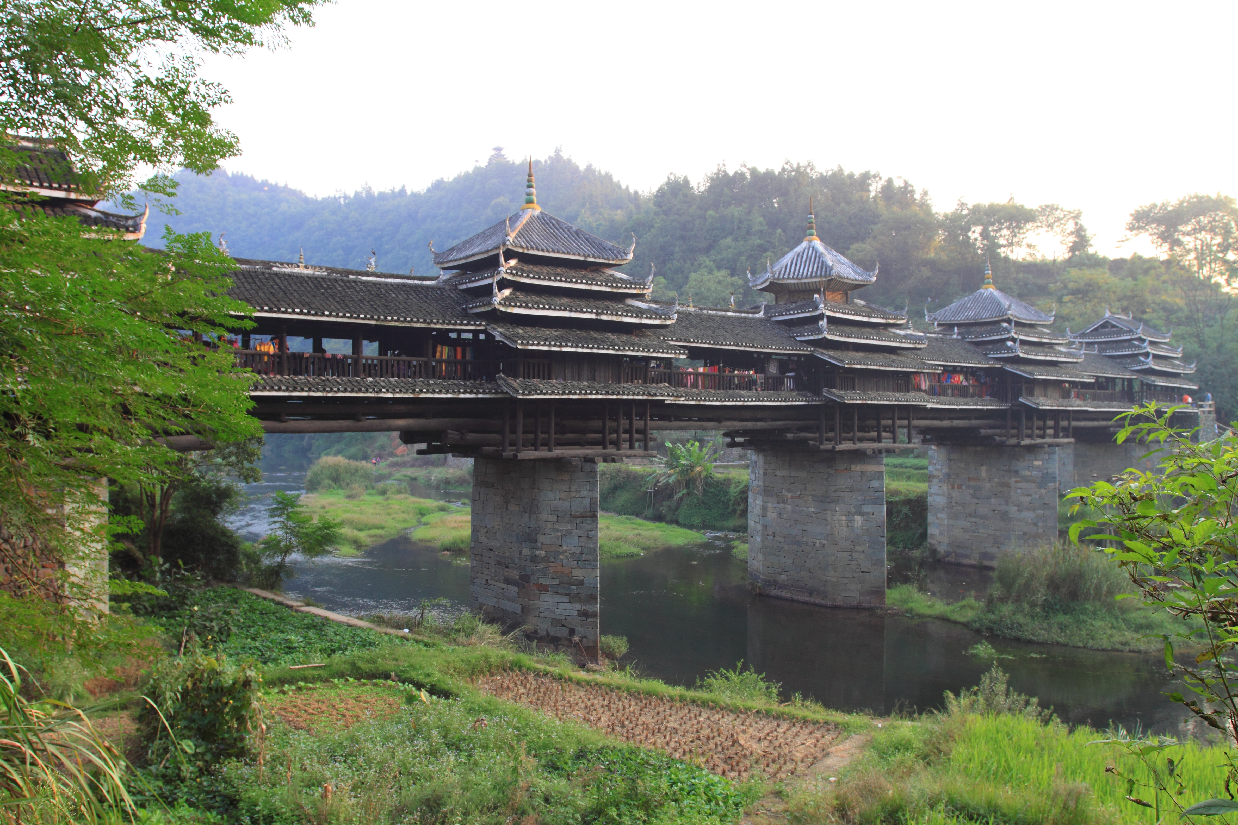
Interesting facts
The Chengyang bridge got it’s name from it’s ability to protect from natural weather conditions!

Slide 8

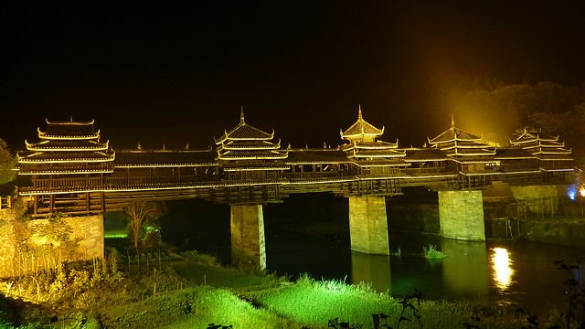
Chengyang vs. Brooklyn bridge
The Brooklyn Bridge is 1,760.443 meters longer than the Chengyang bridge! ☹ ☺ ?

Slide 9
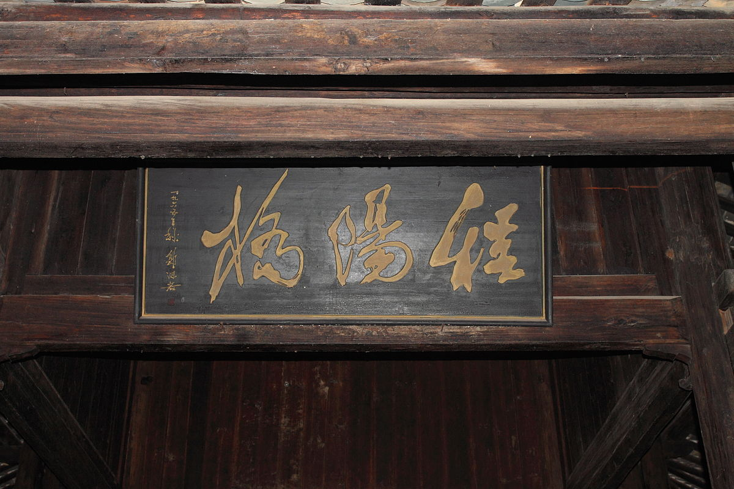
Researched and produced by Lillian 3rd grade Buck Lake Tally, FL
Hope you liked it!
I got this information from BridgesDB.com and Ducksters.com

